Slide 1
Python programming
unit A5 – linear regression

Slide 2
Machine learning
Machine learning is a discipline that deals with the study of methods for pattern recognition in datasets undergoing data analysis.
learn from data
build model
make predictions

Slide 3
Machine learning
Supervised learning
Classification: the target belongs to two or more classes or categories.
Regression: the target to be predicted has continuous variate.
Unsupervised learning
Clustering: discover groups of similar examples in a dataset
Dimensionality reduction: consider a dataset with $n$ columns (variates) data, it can be treated as a n-dimensional feature space. dimensionality reduction is to find new data from original and then makes the higher dimension turns into lower dimension which is easier for training the model.
The methods in which the training set contains additional attributes that you want to predict (*the target, or dependant variate*)
the methods in which the training set consists of a series of input values $x$ without any corresponding target value.

Slide 4


Linear regression
For the set of sample data, there is one dependent, and all others are independent features.
The dependent variable and other features are linear relation.
Linear regression: use the sample data, find the coefficients ($b_{i}$) and intercept ($a$), which fits all sample data in the best way. (least variance)
$$y=a+ \sum_{i}{b_{i}x_{i}}$$

Slide 5
Packages to use
Scipy.stats
Linregress()
Scikit-learn
Linear_model.LinearRegression()
statsmodels
OLS(), add_constant()
pip install -U scikit-learn
conda install -c anaconda scikit-learn
pip install statsmodels
conda install -c conda-forge statsmodels

Slide 6
Examples
Collect and read_csv for WHO data
Collect and read_html for yearly sunshine data
Use worldbank data source in pandas, read GDP data
Single variable linear regression: WHO country suicide rate ~ country sunshine data
Multi variable linear regression: WHO country suicide rate ~ (country sunshine data, country GDP)

Slide 7
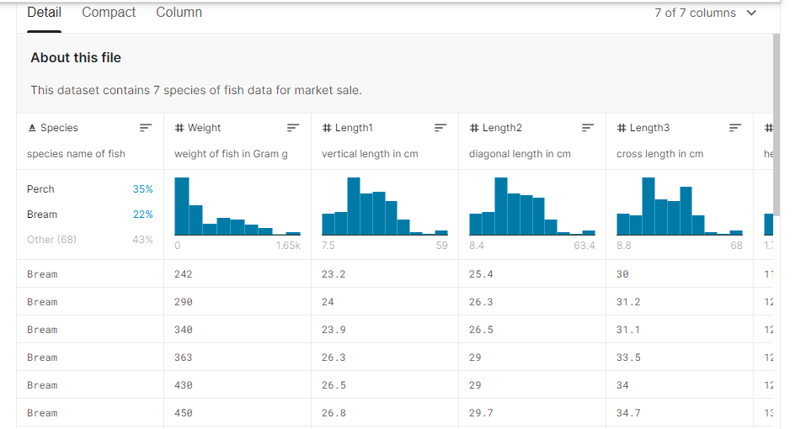
tasks
Fish dataset
https://www.kaggle.com/aungpyaeap/fish-market/
Use the fish dataset, to do linear regression, find how the weight is related to height, width, and length.

